Slide 1
Automatic Scaling of Selective SPARQL Joins Using the TIRAMOLA System
E. Angelou, N. Papailiou, I. Konstantinou, D. Tsoumakos, N. Koziris
Computing Systems Laboratory, National Technical University of Athens
Semantic Web Information Management - SWIM 2012

Slide 2
Motivation – the story(1)
‘Big-data’ processing era
(Web) analytics, science, business
Store + analyze everything
Distributed, high-performance processing
From P2P to Grid computing
And now to the clouds…
Traditional databases not up to the task

Slide 3
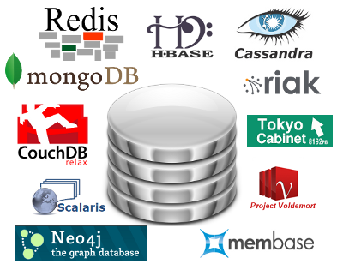
Motivation – the story (2)
NoSQL
Non-relational
Horizontal scalable
Distributed
Open source
And often:
schema-free, easily replicated, simple API, eventually consistent /(not ACID), big-data-friendly, etc
Column family, Document store, Key-Value, …

Slide 4
NoSQLs and elasticity
Many offer elasticity+sharding:
Expand/contract resources according to demand
Pay-as-you-go, robustness, performance
Shared-nothing architecture allows that
Important! See Apr 2011 Amazon outage (foursquare, reddit,…)

Slide 5
thus…(end of the story)
PaaS and NoSQLs are (or should be) inherently elastic
How efficiently do they implement elasticity?
NoSQLs over an IaaS platform
EC2, Eucalyptus, OpenStack,…
Study that registers qualitative + quantitative results
Related Work
Report NoSQL performance (not elasticity)
Cloud platform elasticity (no NoSQL)
Domain-specific
Initial cluster size (not dynamic)

Slide 6
Contributions
TIRAMOLA: A VM-based framework for NoSQL cluster monitoring and resource provisioning
For a cluster resize, identify and measure
Cost, gains
In terms of:
Time, effort, increase in throughput, latency, …?
A generic platform:
any NoSQL engine
User-defined policies
Automatic resource provisioning
Open source: http://tiramola.googlecode.com
Use-case: Distributed SPARQL query processing

Slide 7
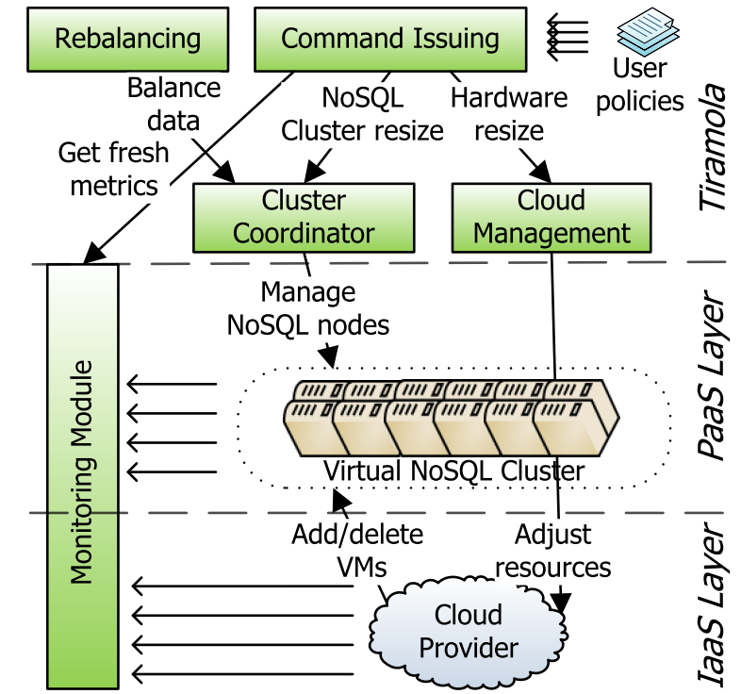
TIRAMOLA Architecture

Slide 8
Platform Setup
8 physical nodes
2xSixCore Intel Xeon® Hyperthreading (@2.67Ghz)
48GB RAM, 2 X 2TB RAID 0 disks each
VMs
Similar to an Amazon EC2 large instance
4-core processor, 8GB RAM, 50GB disk space
QCOW image: 1.6GB compressed, 4.3GB uncompressed
VM root fs instead of EBS (Reddit outage)
Openstack 2.0 Cluster

Slide 9
Clients, Data and Workloads
Hbase (v. 0.20.6), Cassandra (v. 0.7.0 beta)
Hadoop 0.2.20
Replication factor: 3
8 initial nodes (VMs)
Ganglia 3.1.2
YCSB tool
Database: 20M objects – 20GB raw (Cass ~60GB, Hbase ~90GB)
Loads: UNI_R, UNI_U, UNI_RMW, ZIPF_R
Default: uniform read, 10%-50% range
λ parameter (tricky)
Both client (YCSB) and cluster (Ganglia) metrics reported

Slide 10
The setup
λ_{start}=180Kreqs/sec (way over critical point)
At time t=370sec:
Double the cluster size (add extra 8 nodes)
Triple the cluster size (add extra 16 nodes)
4 different experiments for each database
READ+8, READ+16, UPDATE+8 and UPDATE+16
Measure client, cluster-side metrics
query latency, throughput and total cluster usage
Vs time

Slide 11
2. HBase cluster resize 1/2
Transient negative effect in read workloads
HMaster reassigns regions
Clients experience cache misses
Effect is more apparent in READ+8
A larger cluster absorbs load more easily
Updates experience oscillations
Compaction effect
Incoming data is cached in memory (low latency)
When memory is full, data is flushed to disk (high latency)

Slide 12
2. HBase cluster resize 2/2
For READ, throughput is (roughly) doubled and tripled
More servers handle more requests
Data is not transferred, but it is cached
Update is not affected
I/O bound operation
Updates will be handled by the initial 8 nodes
Only new regions due to compaction will be served by new nodes

Slide 13
2. Cassandra cluster resize 1/2
READ workloads
Initial latency goes to 1/2 and 1/3 of 22 secs
More servers join the ring and take requests
No transient effect because of decentralized p2p nature
UPDATE workloads
The same effect as in the read case
Writes are faster than reads due to weak consistency model

Slide 14
2. Cassandra cluster resize 2/2
READ workloads
Similar trend as in the latency case
UPDATE workloads
Same almost linear effect
Weak consistency model
READ workloads
CPU decreases to 60% and 50%
Load is enough for every node to contribute
UPDATE same as READ

Slide 15
What about the time cost?
VM initialization
3min for addition, negligible for removal (few secs)
Node configuration
Config files and propagation (at most 30 sec cycle)
Region rebalance
Actively participate in the NoSQL cluster
Cassandra more efficient, Hbase depends on data, #nodes,…
Data rebalance
Optional
Hbase: data / cluster-size dependent (+2h)
Cassandra: individual loadbalance signals

Slide 16
Use-Case: Scaling SPARQL Joins
H₂RDF: Storing RDF triples over a cloud-based index
(s,p,o) permutations for efficient access
HΒase store
WWW’2012 demo, code at http://h2rdf.googlecode.com
Adaptive joins
Map-Reduce joins
Centralized joins
SPARQL querying
Jena parser
Join planner

Slide 17
SPARQL Querying Architecture

Slide 18
Elasticity-provisioning use-case
Dataset:
LUBM (5k Universities, 7M triples, 125 GB)
Queries:
SELECT ?x
WHERE {?x rdf:type ub:GraduateStudent .
?x ub:takesCourse <...>} for different courses
Load
Sinusoidal (40qu/sec avg, 70qu/sec peak, 1h period)
Objective function
CPU load, 50% – 60% thresholds

Slide 19
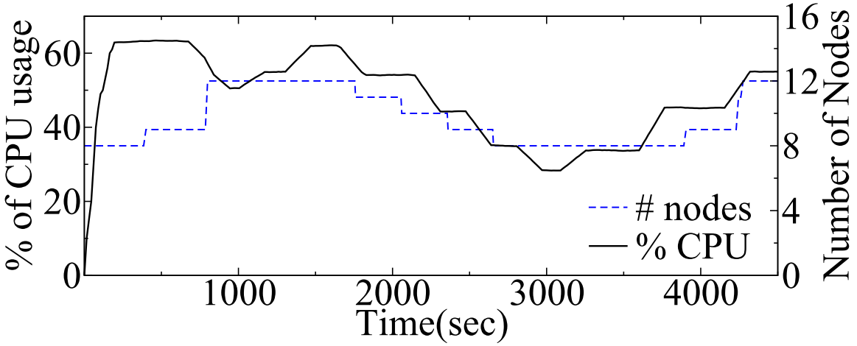
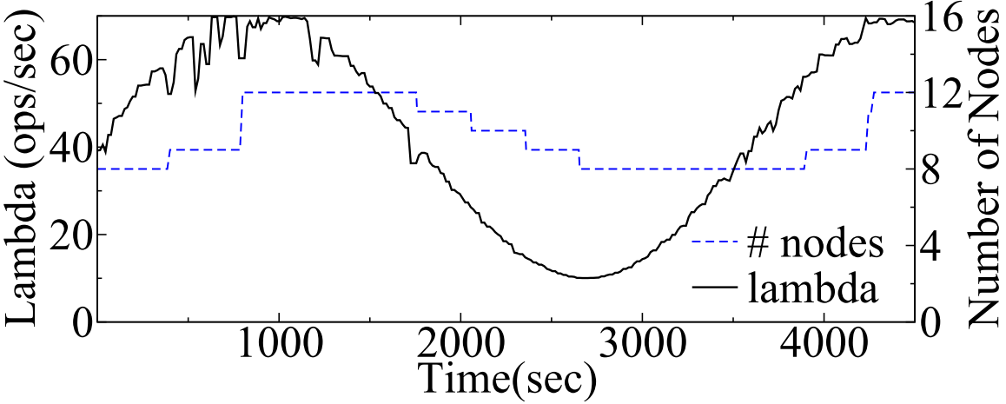
Results
Elastic operations
Pay as you go

Slide 20
Questions
?
“TIRAMOLA: Elastic NoSQL Provisioning through A Cloud Management Platform” – SIGMOD 2012(Demo Track)
Demo C
“On the Elasticity of NoSQL Databases over Cloud Management Platforms” – CIKM 2011
“Automatic, multi-grained elasticity-provisioning for the Cloud” – FP7 STReP (accepted for EU funding, kickoff date 9/2012)
http://tiramola.googlecode.com

